Slide 1

Coffee sales Report

Slide 2
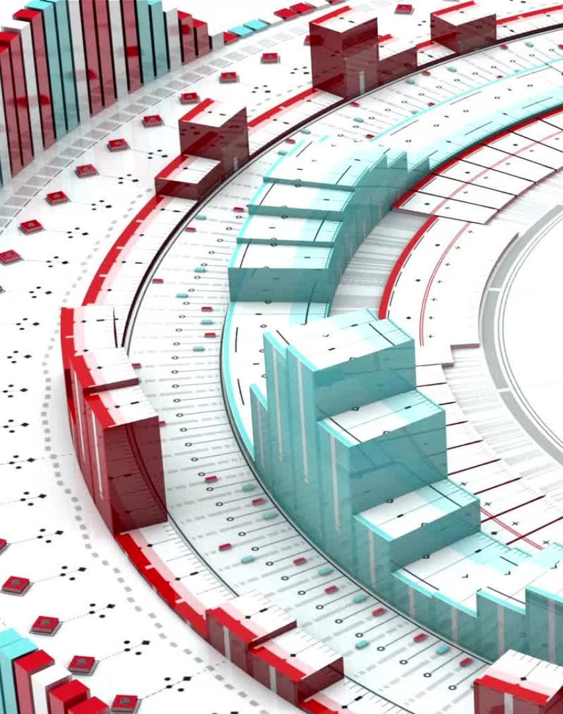
☕Understanding your Data
we've cleaned and prepared your data, explored it through visualizations to find interesting patterns, and built and evaluated several machine learning models to predict sales categories based on the day of the year, identifying the Random Forest model as the best performer based on the F1-score.

Slide 3
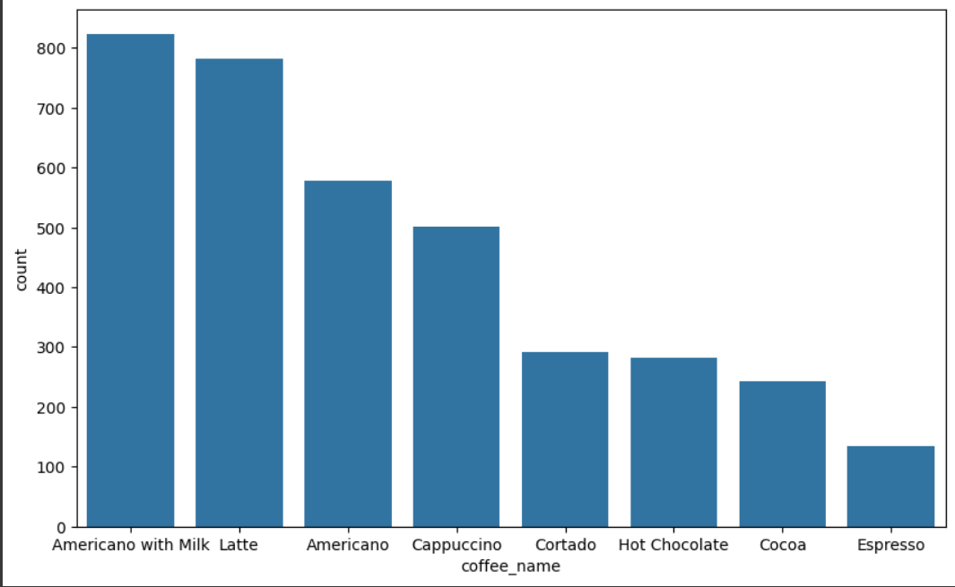
The best selling types of coffee
This visualization is a bar plot showing the count of each coffee name in the dataset. It helps us see which coffee names are the most and least frequent in the sales data. From this plot, we can identify the most popular coffee names based on the number of times they appear in the dataset
And best one is "Americano"

Slide 4
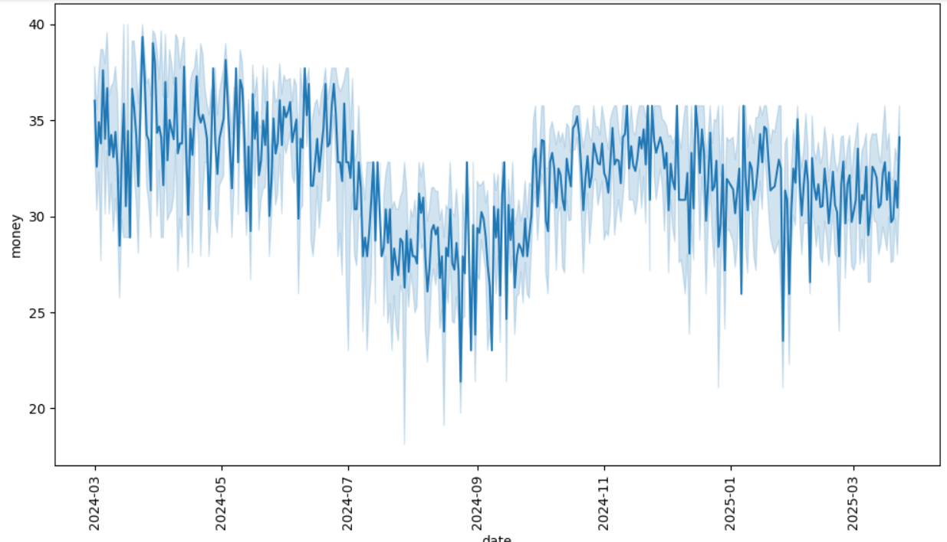
Trending over date
Line: The average money earned over time.
Shaded Area: The range of variation (the highs and lows) — showing how much your earnings fluctuated around the average

Slide 5
📈 Key Insights:
March–June 2024:
High and frequent fluctuations in money earned.
Likely a busy period with strong but inconsistent sales (e.g., seasonal demand, holidays, or promotions).
July–September 2024:
Noticeable drop in revenue.
Also, fluctuations are still present but at lower average levels.
Could be a slow season – maybe due to summer vacations or fewer customers.
October 2024–March 2025:
Revenue starts to rise again and becomes a bit more stable, though still some ups and downs.
Indicates a recovery or return to more normal performance.

Slide 6
☕ What You Can Do
Investigate the Dip (July–Sept 2024):
Was it due to fewer customers, weather, staff issues, marketing drop, or competition?
Capitalize on Strong Periods (March–June & After October):
Run more promotions or events during high-performing months.
Maybe replicate what worked in early 2024.
Reduce Fluctuations:
Try to smooth your revenue by offering consistent promotions, loyalty programs, or seasonal menus.

Slide 7
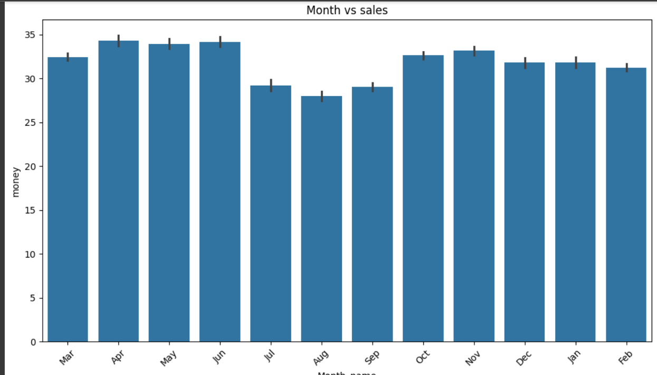
Sales in Month
🔢 Month | 💵 Average Sales | 📌 Notes
Apr–Jun | Highest (near 34–35) | 🟢 Best-performing period
Jul–Sep | Lowest (~29–31) | 🔻 Drop in sales — slow season
Oct–Dec | Stable recovery (~32–34) | 🔄 Picked up again
Jan–Feb | Slight decrease (~32) | 🟡 Slight slowdown

Slide 8

🧠 Business Insights
Best Months:
April, May, June – High sales! 👉 Consider repeating marketing, offers, or promotions that worked in these months.
Slowest Months:
July, August, September – Sales dipped. 👉 Time to boost advertising, launch seasonal products, or offer discounts.
Steady Period:
October to January shows consistent performance — keep doing what you're doing!
🛠 What You Can Do:
Create promotions in weak months to boost traffic.
Study what worked during strong months (menu items, customer volume, etc.).
Use this to plan your stock, staff, and budget more efficiently.

Slide 9
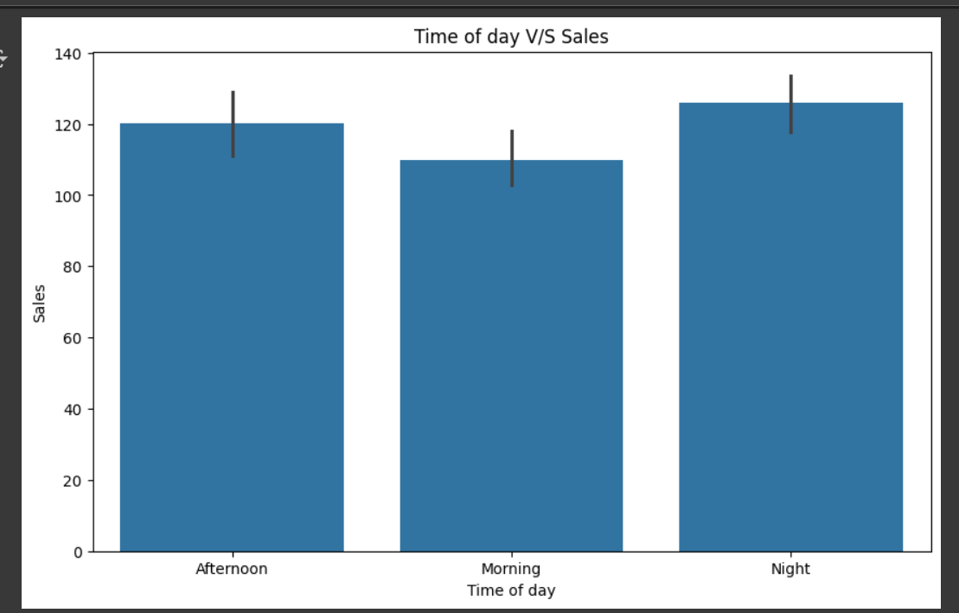
📊Time of Day vs Sales
🕒 Breakdown by Time:
Morning: You have the lowest number of sales.
Afternoon: Sales are a bit higher than the morning.
Night: You have the highest number of sales

Slide 10
What can you do as owner..!
1.Focus on Night Time:
Since sales are highest at night, you can:
Keep the shop open later.
Add more staff during this time.
Promote night-time deals or events.
2. Improve Morning Sales:
Offer breakfast combos or discounts for early customers.
Partner with nearby offices or schools for morning deliveries.
3. Monitor Afternoon Sales:
It's doing okay, but there's room to grow.
Consider “Afternoon Happy Hour” or loyalty cards

Slide 11

Models we did
We've taken a first step to see if the calendar alone can tell us about your sales. We found a model (Random Forest) that's better than others at this task

Slide 12

Owner's Guide: Improving Coffee Shop Performance
Stock Smart: Prioritize ingredients for top sellers like Latte and Americano with Milk.
Staff for Rush Hour: Schedule more employees during the busiest times of the day.
Boost Sales in Slow Months: Run promotions during months with historically lower sales.
Watch External Events: See how local happenings, weather, etc., affect your sales.
Understand Your Customers: Analyze loyalty or card data to learn about frequent buyers.
Plan for the Future: Consider more advanced forecasting to predict specific sales numbers.

